Slide 1


Leading a Healthy Lifestyle
Sarah Brook BSc, RD
Dietitian at Pilgrim Hospital

Slide 2
Health Behaviour
‘Noun: An action taken by a person to maintain, attain, or regain good health and to prevent illness. Health behaviour reflects a person’s health beliefs’

Slide 3
Aims of the presentation
To inform and discuss what a ‘healthy lifestyle’ means
To help you identify health behaviours you could incorporate into your lifestyle
To answer your questions on a healthy lifestyle

Slide 4
‘The Holy Four’
Some researchers termed the following the holy 4 as they have a big impact on disease;
Smoking
Drinking
Nutrition
Physical Activity

Slide 5

Craving to Quit?
Single most important lifestyle change to bring
about health benefit
Phoenix Stop Smoking Service in Lincolnshire
01522 574200
Ask your GP or health professional for more info
Support and tips to quit are available at:
www.lincolnshire.nhs.uk/your-health/smoking
Health trainers are also trained in smoking cessation
Stoptober – 28 day stop smoking challenge from the NHS running in England
  Sign up online and get free pack

Slide 6

Watch the Scotch!
Men: 3-4 units/day
Women: 2-3 units/day
2 Alcohol-free days a week
Can’t save units up and binge
Common drinks and their units;
  Pint normal strength beer: 2 units
  175ml glass (medium) wine: 1 ½ - 2 units
  Alcopop: 1 ½ units
  Pub measure of spirit: 1 unit
  Be aware of home measures and calorie content of alcohol

Slide 7
Exercise can be a walk in the park!
A 30 minute
  Brisk walk
  Jogging
  Cycling
  Heavy gardening/housework
  …on >5 days a week
  If it gets you slightly out of breath and a bit sweaty its working!
  Two 15 minute bursts may be just as effective

Slide 8

Nourish Yourself!
The next section will discuss ways in which a healthy diet is achievable;
  Based on current guidelines
  Evidence based
  Cover a wide range of aspects of a healthy diet
  Think of your body as a car; you wouldn’t fuel your petrol car with diesel (on purpose!)

Slide 9
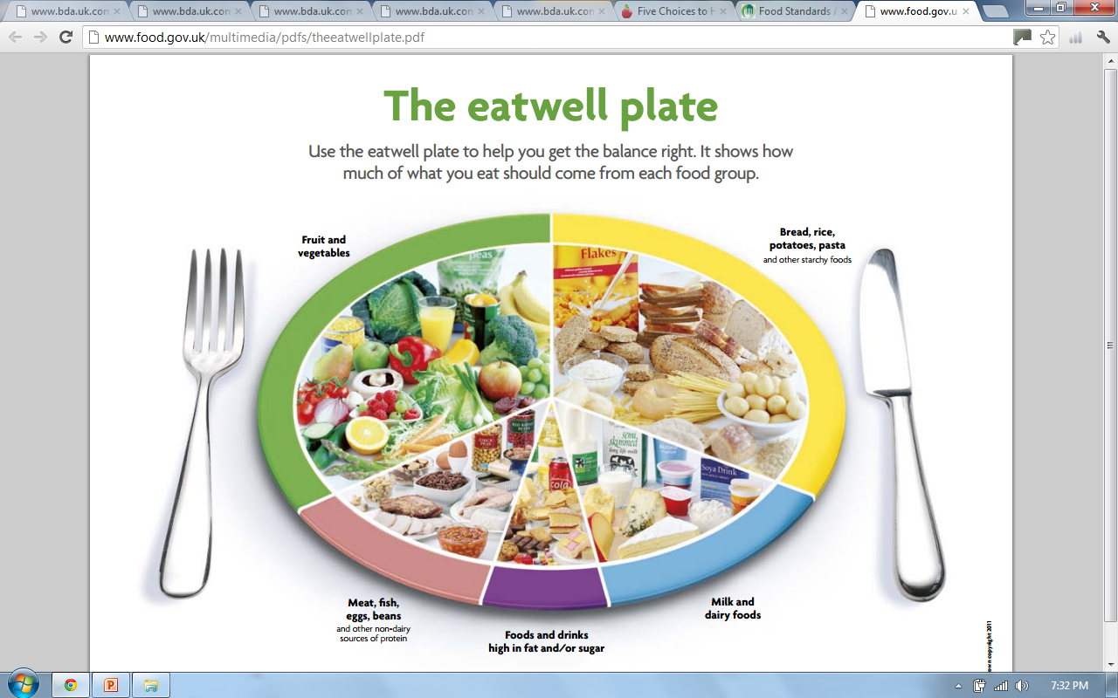
Food Standards Agency, 2007
Notes:
The eatwell plate shows how much of what most adults eat should come from each food group. This includes everything you eat during the day, including snacks.
So, try to eat:
– plenty of fruit and vegetables
– plenty of bread, rice, potatoes, pasta and other starchy foods – choose wholegrain varieties whenever you can
– some milk and dairy foods
– some meat, fish, eggs, beans and other non-dairy sources of protein
– just a small amount of foods and drinks high in fat and/or sugar

Slide 10
33% Starchy carbohydrates
Bulk of meals
33% Fruit & Vegetables
5+ a Day
15% Milk & Dairy
3 portions daily
12% Meat, Fish, Eggs, Beans
Oily fish once a week
<8% High fat/sugary foods
Avoid saturated fats
Proportions taken from food.gov.uk website
Notes:
-Should get all the vitamins and minerals you need from eating a balanced diet meaning most people don’t need a multivitamin supplement
-Most meals we eat are ‘composite/combination’ ones, made up of a mixture of food groups, i.e. sandwich, casserole, pasta dishes. Need to consider how much of each food group the meal consists of and check if your intakes fitting with the suggested proportions

Slide 11
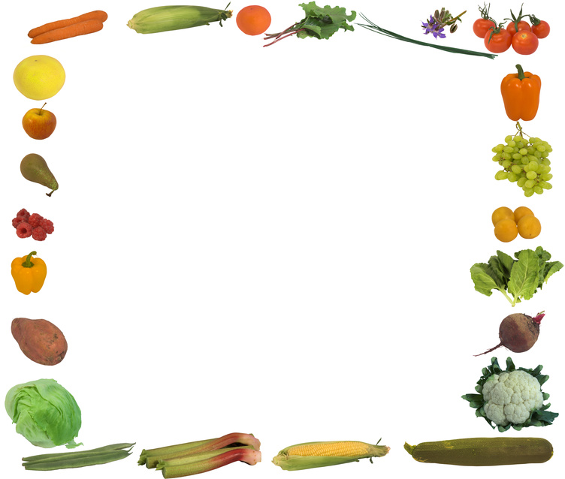
Why 5 a Day?
400g fruit and vegetables a day can help us to stay healthy
Great source of antioxidants, vitamins and minerals
Make a good healthy, handy and sometimes cheap snack i.e. banana 19p!
Help to prevent constipation due to their high dietary fibre content
May reduce risk of cancer, heart disease and stroke
Notes:
Antioxidant – a substance that protects our cells from oxidative damage (i.e. it prolongs the health of our cells). This diet provides a healthy intake for our whole body system, even down to our individual cells!

Slide 12
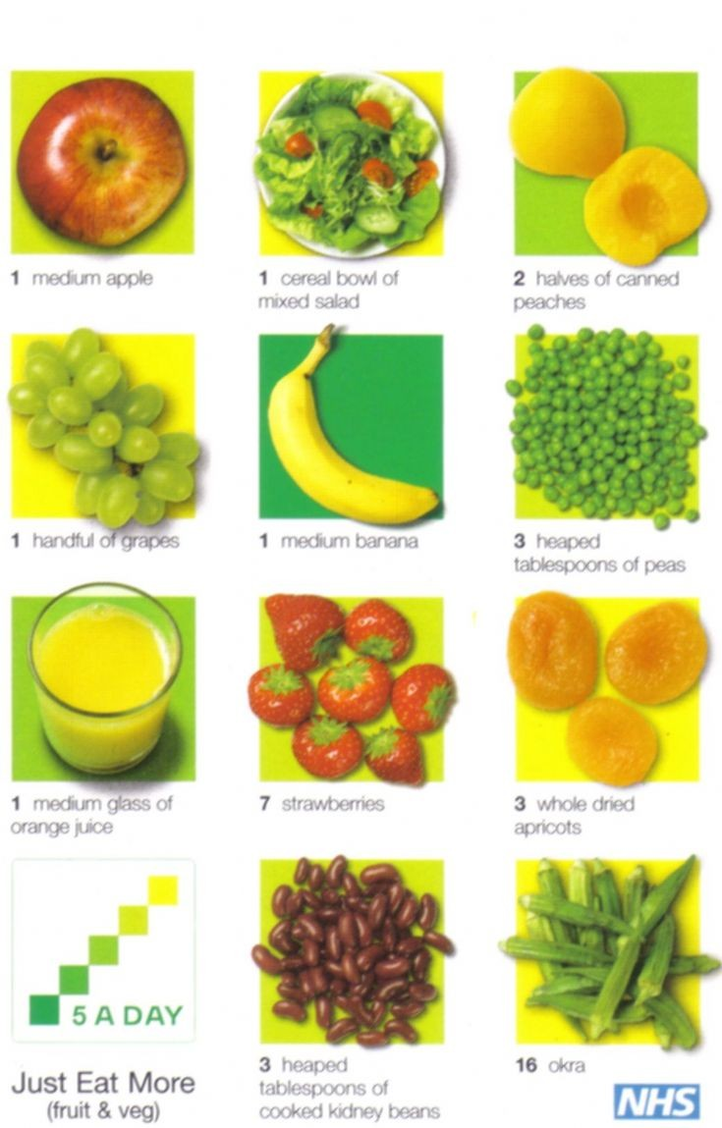

What Counts?
Fresh
Frozen
Tinned
Canned
Dried
Shows a product contains a number of 5 a day
www.dh.gov.uk
Notes:
How many squares filled in shows how many portions of fruit or veg a product provides
Variety is key
Healthy adults should try to avoid consuming fruit and veg with added fat i.e. cream with fruit or butter on veg. fat free yoghurt accompanies fruit well. Also to note that over boiling veg can destroy their vitamin c content.

Slide 13
Food for Thought
Do potatoes count towards our 5 a day target?
  No. They’re classed as a carbohydrate.
Would eating 4 apples mean each could be counted as a portion of fruit and veg?
  Yes. The whole fruit contains all the natural fibre so would count.
Would drinking 5 glasses of fruit juice mean I will have met the 5 a day target?
  No. Only one glass of fruit juice counts towards 5 a day total due to its high sugar content and lack of fibre
Notes:
Fruit juice can have as many calories as sugary pop, something to be aware of if you are aiming to control your weight.

Slide 14
Carbohydrates
Q: What are they?
A: Sugars and starches that provide our bodies with energy (calories) to function
Dietary sources come in two forms;
Simple
  Fructose (fruit sugar), sucrose (table sugar), lactose (milk sugar) and glucose
  Sweets, sugary pop
Complex/starchy
  Bread, flour, rice, pasta, breakfast cereals
  Good source of calcium, iron and B vitamins
Notes:
Simple carbs have 1 or 2 units of sugar. Easier for body to break down to glucose so get absorbed into blood quicker
Complex/starchy made of many units of sugar. Take longer to be metabolised so they provide a slower release of energy.

Slide 15
Fruit and vegetables and pulses also provide carbohydrates; a mixture of starches and sugars
Recommended dietary intake: 33% starchy carbs, 50% total carbs
Our bodies store unused carbohydrate in the liver and muscles but when full, excess carbohydrate is stored as fat
  Too little carbs → weakness, poor concentration (not enough fuel to the brain), constipation
Notes:
-XS CHO stored as fat, highlights why we need to eat it in the right proportions

Slide 16
Q: Are carbohydrates fattening?
A: Gram for gram carbohydrates contain less than half as many calories as fat.
  Cooking methods affect the calorie content of carbohydrate foods, as does adding fats and oils to taste
  Q: What about low carbohydrate diets?
  A: Low carbohydrate diets don’t represent each food group which may lead to symptoms related to the imbalanced dietary intake. Our body quickly moves from obtaining energy from fat stores onto digesting muscles
Notes:
Frying and roasting will mean the cooked carbohydrate product now has much more energy than if it had been boiled, steamed or grilled.
Low fat diets tend to be higher in bad fats too which can increase the risk of heart disease.
- Research shows high carb diets are most beneficial to health

Slide 17

Wholegrains
Wheat, barely, rye, oats and rice
3 layers;
  Fibre rich outer layer (bran)
  Nutrient packed inner area (germ)
  Central starchy part (endosperm)
  Processing removes the bran and germ → white variety
  Surveys show 95% of adults don’t consume enough
  Soluble & non-soluble fibre to prevent constipation, lower cholesterol and encourage healthy gut bacteria
Notes:
The grain is the seed of these cereal crops
By removing the bran and germ (white bread, pasta, rice etc) you can see that a lot of the fibre and nutrients including B and E vitamins are removed
Fibre reduces transit time therefore reducing the time when damaging substances may be in contact with the gut wall whilst providing a thriving environment for good bacteria which produce gut protective substances

Slide 18
  May risk of type 2 diabetes, heart disease and some cancers
Aim for 3 servings daily
Low ‘GI’ (slow release of energy) which may keep you fuller for longer
Look out for ‘Whole’ before the name of the cereal
  Ideas:
    Wholegrain cereals and cereal bars with yoghurt or milk for breakfast or as snacks
    Wholemeal, granary, multigrain bread instead of white
    Oatmeal and whole-oats to make flapjack
    Quinoa, bulgur wheat, brown rice in salads or with curries

Slide 19
Protein: Meat, Fish and Alternatives
  Moderate amounts
  Choose low fat/lean options where possible
      Cut visible fat off meat products and avoid poultry skin
  Try avoid processed meat products due to their high saturated fat content
  Fish twice a week (not fried!), one oily
      Eggs – FSA puts no limit on intake
      Mycoprotein (QuornTM), soya protein and tofu are also good low fat protein sources
Notes:
-Poultry meat has increased considerably in fat content over recent years. White breast meat with no skin has the least amount of fat.
- Omega 3 sources in descending order of quantity of omega 3
- Eggs contain dietary cholesterol however this has little effect blood cholesterol levels

Slide 20
Protein: Milk and Dairy
2-3 portions daily
Milk (1/3 pint), cheese (40g), yoghurt (1 pot)
Healthy adults should choose low fat options if possible
Plant based alternative milk drinks i.e. soya better to get fortified sugar free version
Snack/dessert idea:
  Try plain yoghurt with strawberries or blueberries for sweetness or adding it to curries instead of cream
Notes:
Low fat dairy products contain the same amounts of calcium and protein as their full fat alternatives but less fat and energy
Research suggests soya milk may be beneficial in lowering bad cholesterol

Slide 21

High Fat/Sugary Foods
<8% of intake
Can be consumed as part of a healthy balanced diet
Include crisps, sweets, cakes, biscuits, sugary drinks
Provide relatively little nutritional benefit
Many are highly processed so may contribute a large amount of salt to the diet

Slide 22
Fat
We need some fats in our diet as they provide energy and some vitamins. Some our body cannot make; essential fatty acids (EFAs)
Saturated (animal products)
Trans (cakes/biscuits)
↑ blood cholesterol
Monounsaturated (olive/rapeseed oils, avocados)
Polyunsaturated (sunflower, corn, sesame oil)
  ↓ blood cholesterol
Notes:
Saturated – hard at room temp
Trans – veg oils that have been processed to make them hard (on ingredients list as partially hydrogenated veg oil)
It is recommended to reduce sat & trans fats and increase mono and polyunsaturated fats for heart and overall health.

Slide 23

Omega 3
EFAs: our body cannot make them so we have to obtain them through dietary sources
Sardines
Salmon
Mackerel, kippers
Herrings
Tuna
Swordfish
Halibut, trout
Plant sources linseed, walnuts and walnut oil
Healthy Heart
Notes:
Tinned tuna – canning process removes omega 3

Slide 24
How to saturated fat intake
Grill, boil, steam or poach instead of frying and roasting
Cutting off all visible fat, removing poultry skins, skim fat off mince from casseroles
Use an olive based or low fat spread instead of butter
Choose lower fat dairy products
Keep hidden sources of saturated fat to a minimum i.e. biscuits, pies etc.

Slide 25
Salt is falling, all around us
Consuming too much salt in our diet can lead to high blood pressure → risk of heart disease and stroke
Lots of foods have hidden salt – check labels
Current average intake is
  8.6g (2 tsp)
  Recommended: 6g
  ~ 75% of salt is hidden in food already!
    Ready meals, soup, sauces, cereals, crisps
    stock cubes, processed meats, smoked fish
Notes:
Lowering salt intake it is possible to reduce your blood pressure and therefore reduce your risk of developing heart disease and stroke

Slide 26
Tips to reduce salt intake
Don’t add during cooking or at the table
Use herbs and spices or lemon juice
Look at labels, check for lower salt varieties
Ask in restaurants for no salt
2 weeks no salt – taste buds can adjust so persist

Slide 27
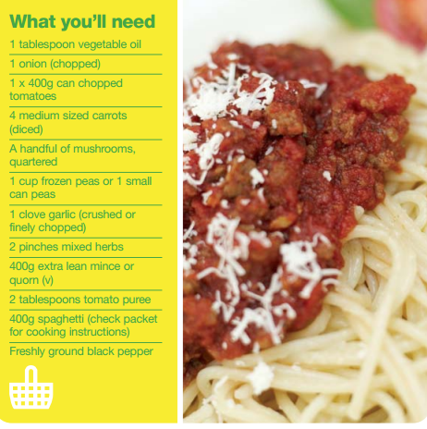
Spaghetti Bolognaise
Serves: 4
Cost per serving: £0.83
2 veg portions per serving, or 3 if served with a side salad
Mince can be swapped for lentils
Kidney beans could be added to make into chili (also count as a portion)
http://www.nhs.uk/Livewell/5ADAY/Documents/Downloads/Fuel_for_Living_Recipe_Booklet[1].pdf
Notes:
- Internet: NHS.uk 5 a day website from the ‘Fuel for Living’ recipe Booklet, available to download. This recipe can be adapted to make chilli con carne (add spice), lasagne (choose lasagne sheets and add white sauce)
- You can see that a serving of this Spag bol has been calculated to cost 83p (dependant on where you shop), consider how much it might cost to buy this from a restaurant or how much the cost of some pre-cooked versions of this meal could be, which may contain more salt, saturated fat and less of the 5 a day target
- Consuming a healthy diet doesn’t have to be expensive!
- Can freeze portions if you have left overs

Slide 28
Meal Pattern
Regular balanced meals are recommended
Missing meals may result in higher quantities of high energy foods being craved and consumed
Plan ahead
Meal times are a good opportunity to get the family together
‘Breakfast is the most important meal of the day’ - break the fast!
  people who consume a fortified breakfast cereal tend to have higher intakes of vitamins and minerals

Slide 29
Watch your Weight
After eating we should feel satisfied, not stuffed!
Measurement of weight to height used by most health professionals;
- BMI (Body Mass Index)
A BMI outside of the desirable 20-25Kg/m² may reflect a higher risk of developing health problems

Slide 30
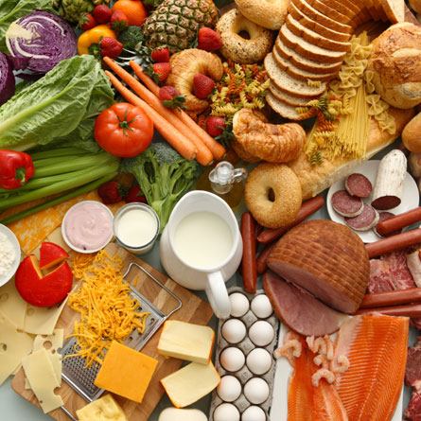

Aim to lose weight slowly (1-2 pounds/week)
Input V Output
Base intake on the Eatwell Plate
Notes:
A 500Kcal reduction in energy daily can result in healthy weight loss of 1-2lbs

Slide 31
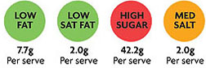
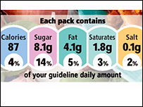
Nutrition Labelling
Look out for;
  Fat & saturated fat, sugar, salt
All food labels contain a nutritional analysis panel which is key to choosing a healthier diet
These will tell you how much of each nutrient there is in a single portion and /100 grams
Notes:
Food manufacturers portion sizes may be different to ours!
Government are in the process of working with food manufacturers to bring in a UK wide traffic light system to reduce confusion around food labelling and differences in branded labels
Can find info

Slide 32
The Media
Health claims often reported
in the media
Sponsored studies → biased results
Sample sizes of the test group may be small so the results can’t be generalised to everyone
Financial gain? Some products expensive
Be critical, may have to take with a (small) pinch of salt!

Slide 33
Public Health Websites
Change4Life:
  Great website aimed at families
  Discusses practical ways to achieve a ‘healthy lifestyle’
  ‘Eat well, move more, live longer’ (Change4Life, 2012)
NHS Choices:
  Information resource for diet, health and lifestyle in general
  Gender and age sections

Slide 34
Summary
Hopefully now you feel informed about what a ‘healthy lifestyle’ means and are able to identify health behaviours you could incorporate into your lifestyle
Eat sensibly, choosing a range of foods in the correct proportions
Move often
Drink moderately
If you smoke, try to stop
Notes:
If you would like more in depth, tailored advice about your diet or specific medical condition ask your GP to refer you to a dietitian

Slide 35
Thank you for listening
Any questions?

